Slide 1

Good evening

Slide 2

Exciting things

Slide 3

One more thing

Slide 4


Slide 5


Slide 6
• Revolutionizing e-testing
• Flexibility for the teacher
• Automated correction

Slide 7


Slide 8

Modules

Slide 9
Networking
• Invigilator interface
• Web interface
Core
• Disable Android UI
• Encryption
• Answer sheet

Slide 10


Slide 11


Packet
HTTP Socket
Packet
Packet
Packet

Slide 12
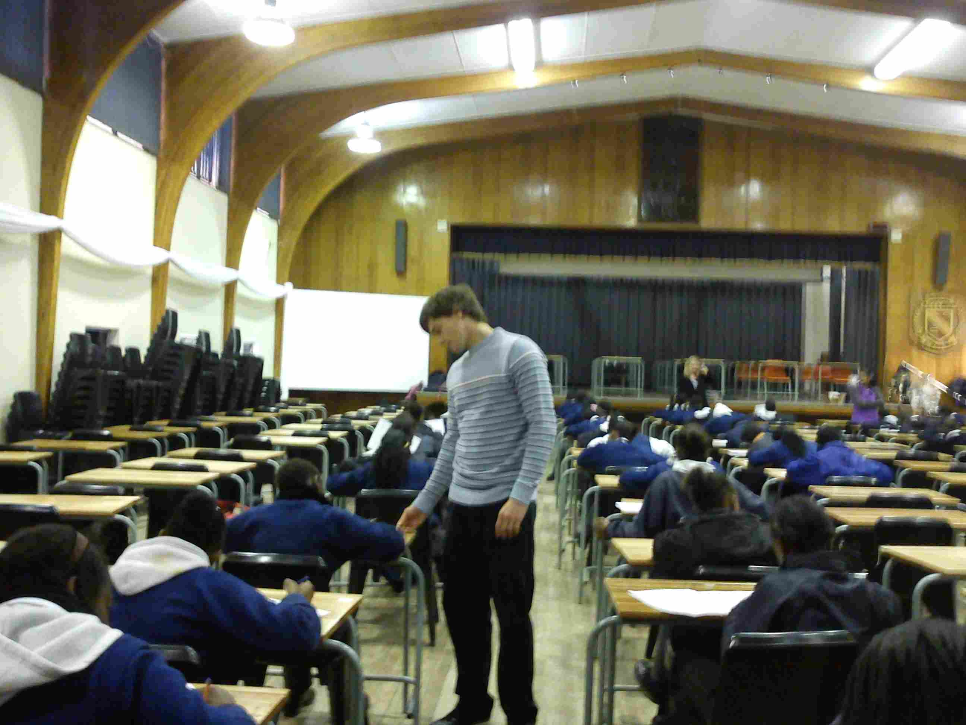

Slide 13
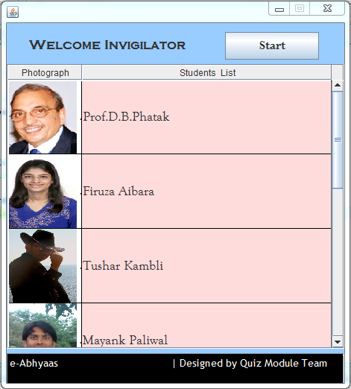
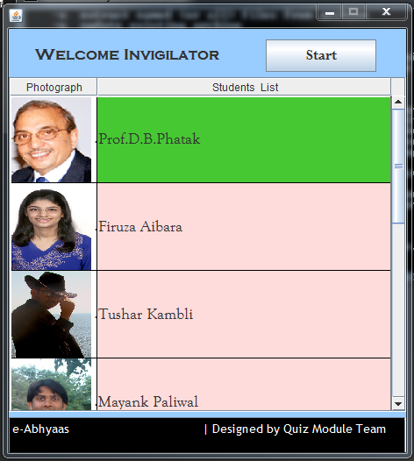
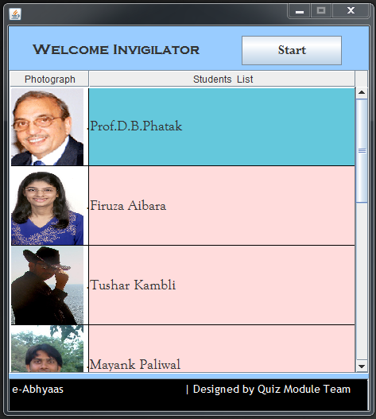
Transferring data
Data transferred

Slide 14


Slide 15
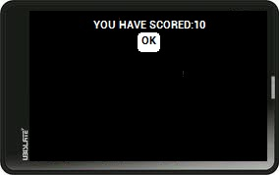

Slide 16


Slide 17
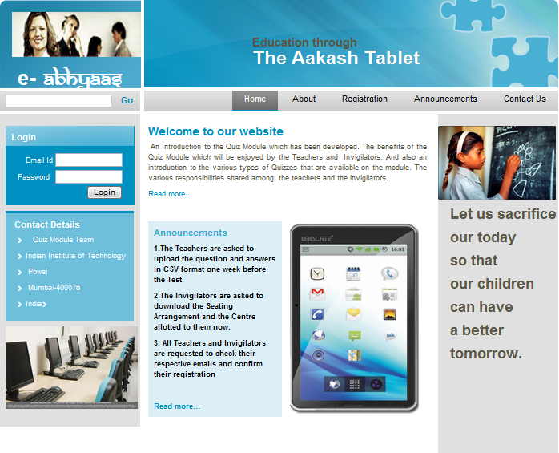

Slide 18
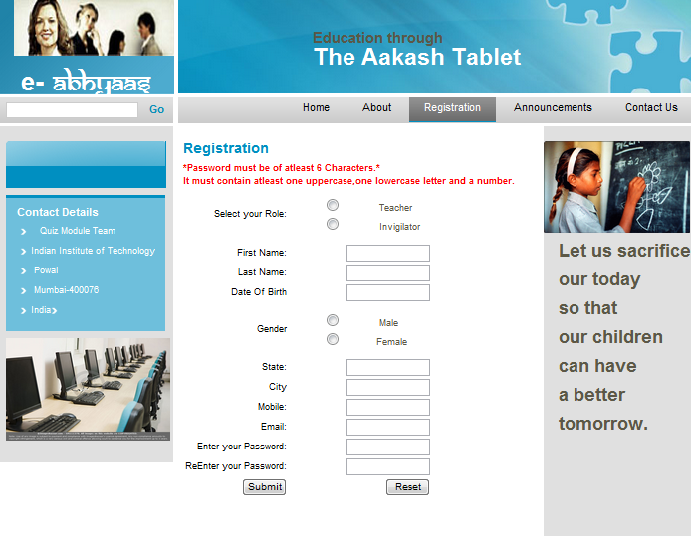

Slide 19
Teacher

Slide 20
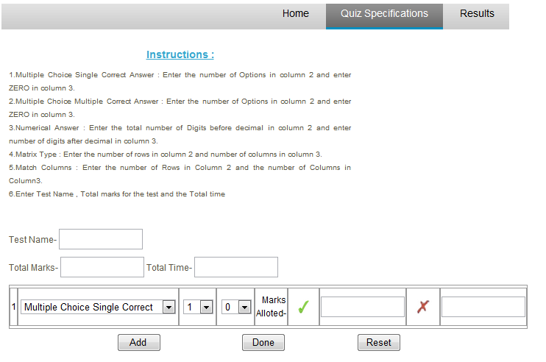

Slide 21
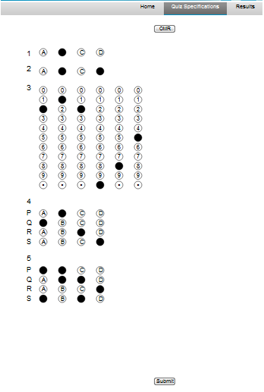
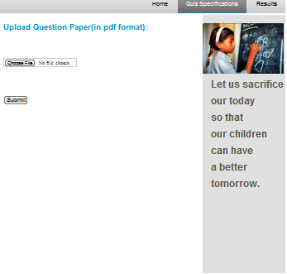

Slide 22
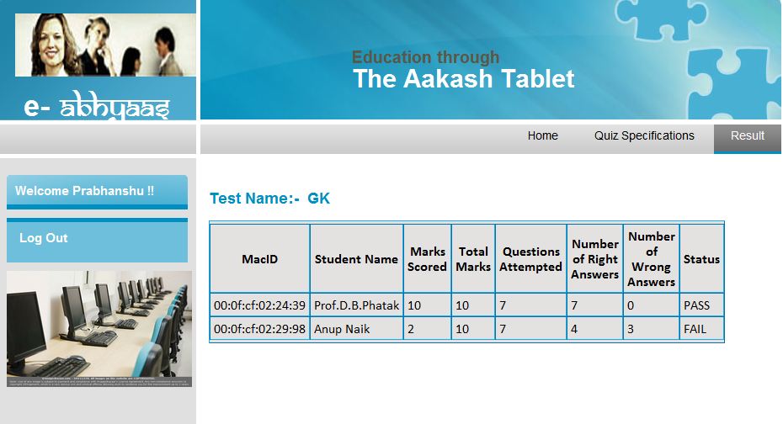

Slide 23
Invigilator

Slide 24
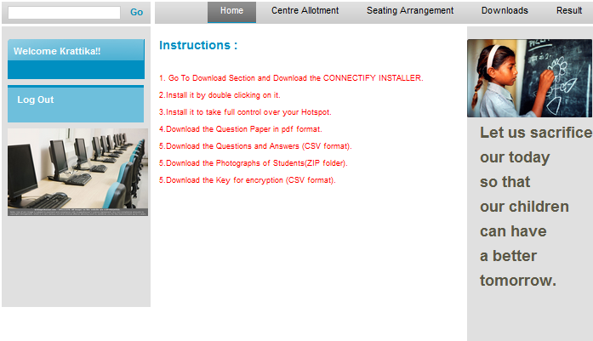

Slide 25
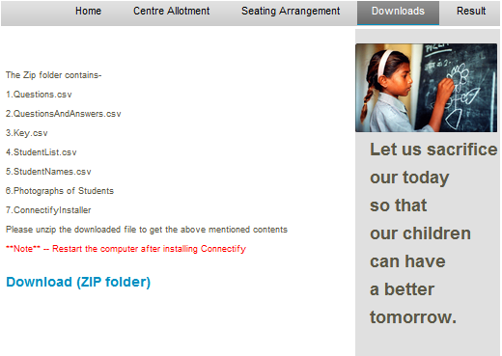

Slide 26
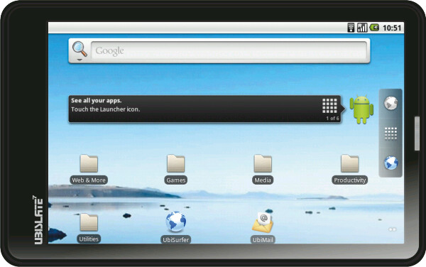
Disabling

Slide 27
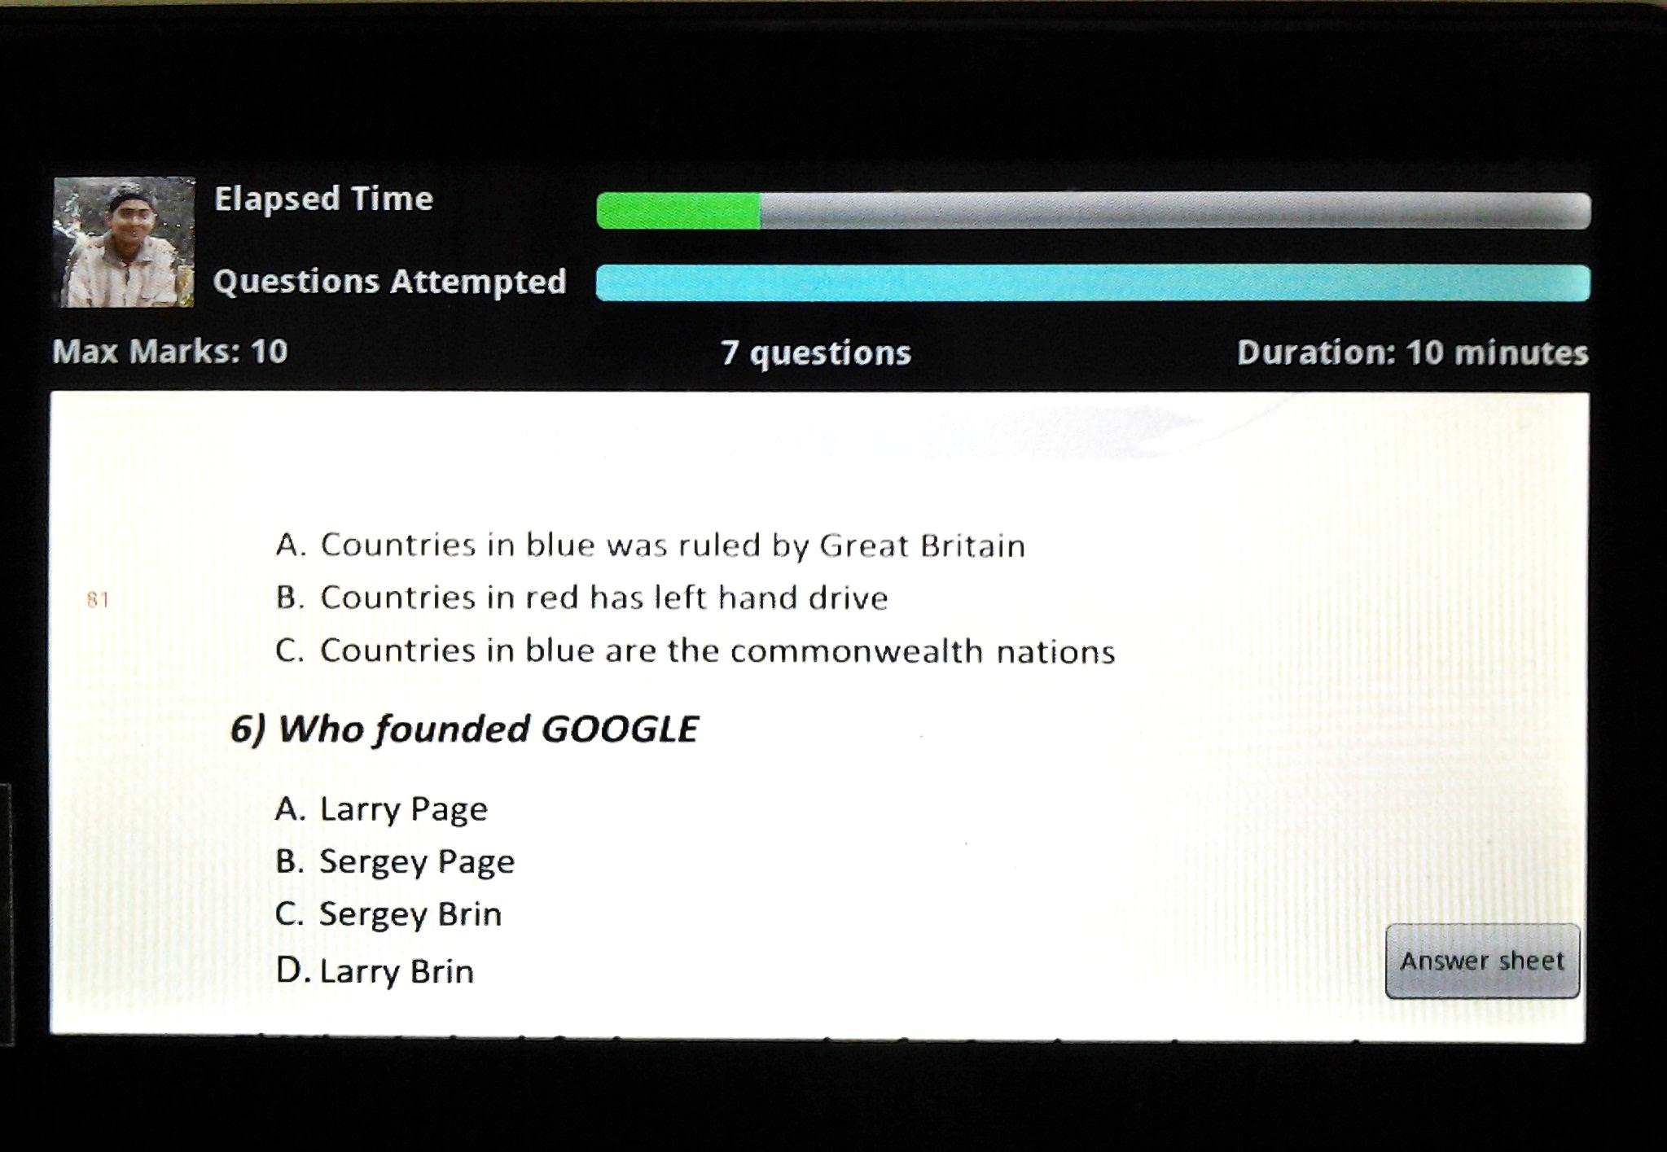

Slide 28


Slide 29
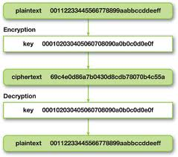

Slide 30
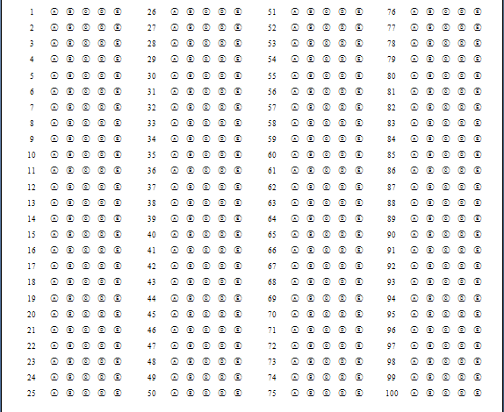

Slide 31
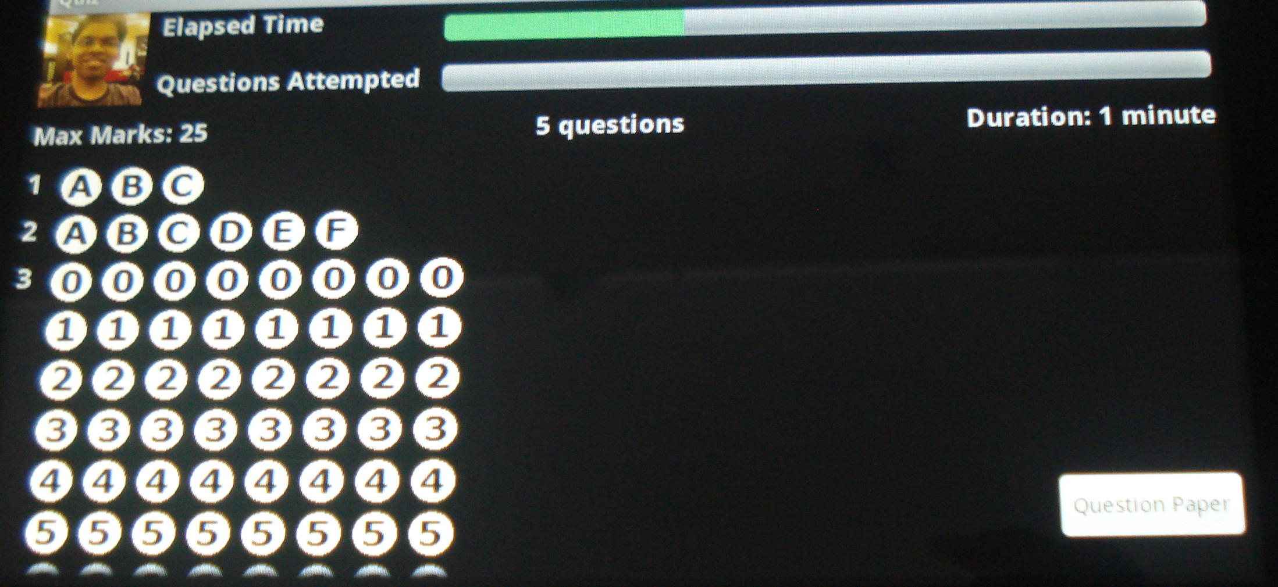

Slide 32
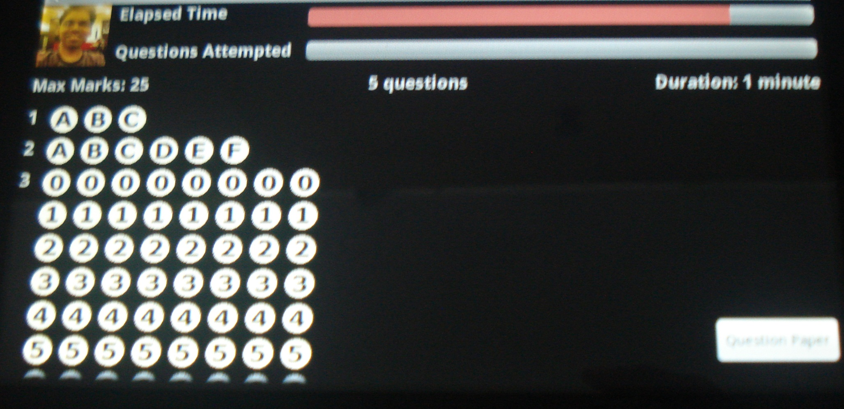

Slide 33
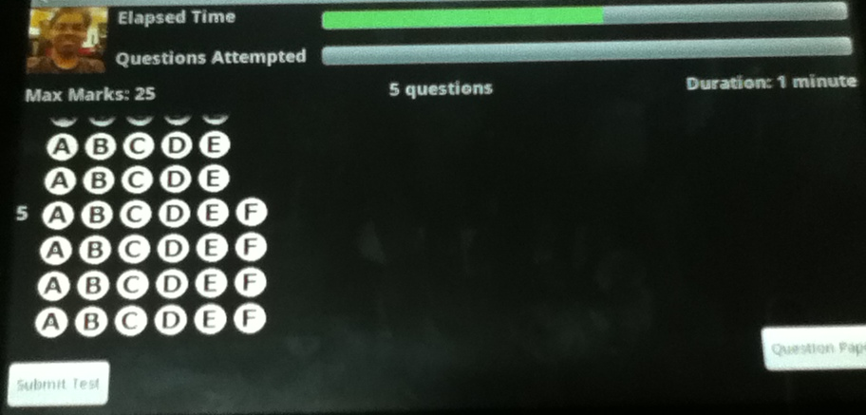

Slide 34
Future Scope

Slide 35


Slide 36


Slide 37


Slide 38
Demo

Slide 39


Slide 40


